Slide 1
Sample
Final Exam with Explanation
Adjunct Instructor – Charles W (Bill) Marshall
cmarshall0050@kctcs.edu

Slide 2
CIT 170 (3 Credit Hours)
Database Design Fundamentals
Sample
Final Exam with Explanation
Adjunct Instructor – Charles W (Bill) Marshall
cmarshall0050@kctcs.edu
While Blackboard will be the official site for assignments and to turn in assignments
Supplemental information is available at https://www.cwmclass.com

Slide 3
Create an ERD, with SqlDBM.com, for this situation.
A City recreation department manages activities for multiple sports.
There are several venues in the city each is suitable for one or more sports.

Slide 4
Create an ERD, with SqlDBM.com, for this situation.
A City recreation department manages activities for multiple sports.
There are several venues in the city each is suitable for one or more sports.
Each sport has
  A maximum allowable number of hours for a game(practice).

Slide 5
Create an ERD, with SqlDBM.com, for this situation.
A City recreation department manages activities for multiple sports.
There are several venues in the city each is suitable for one or more sports.
Each sport has
  A maximum allowable number of hours for a game(practice).
  A minimum number for youth on a team

Slide 6
Create an ERD, with SqlDBM.com, for this situation.
A City recreation department manages activities for multiple sports.
There are several venues in the city each is suitable for one or more sports.
Each sport has
  A maximum allowable number of hours for a game(practice).
  A minimum number for youth on a team
  A maximum number for youth on a team

Slide 7
Create an ERD, with SqlDBM.com, for this situation.
A City recreation department manages activities for multiple sports.
There are several venues in the city each is suitable for one or more sports.
Each sport has
  A maximum allowable number of hours for a game(practice).
  A minimum number for youth on a team
  A maximum number for youth on a team
The city manages one or more leagues per sport.

Slide 8
Create an ERD, with SqlDBM.com, for this situation.
A City recreation department manages activities for multiple sports.
There are several venues in the city each is suitable for one or more sports.
Each sport has
  A maximum allowable number of hours for a game(practice).
  A minimum number for youth on a team
  A maximum number for youth on a team
The city manages one or more leagues per sport.
Venues are scheduled in 1-hour blocks.

Slide 9
Create an ERD, with SqlDBM.com, for this situation.
A City recreation department manages activities for multiple sports.
There are several venues in the city each is suitable for one or more sports.
Each sport has
  A maximum allowable number of hours for a game(practice).
  A minimum number for youth on a team
  A maximum number for youth on a team
The city manages one or more leagues per sport.
Venues are scheduled in 1-hour blocks.
Blocks are available from 10 AM until 9 PM and always start on the hour.

Slide 10
Create an ERD, with SqlDBM.com, for this situation.
A City recreation department manages activities for multiple sports.
There are several venues in the city each is suitable for one or more sports.
Each sport has
  A maximum allowable number of hours for a game(practice).
  A minimum number for youth on a team
  A maximum number for youth on a team
The city manages one or more leagues per sport.
Venues are scheduled in 1-hour blocks.
Blocks are available from 10 AM until 9 PM and always start on the hour.
The schedule will be for an 84 day season (12 Weeks).

Slide 11
Create an ERD, with SqlDBM.com, for this situation.
A City recreation department manages activities for multiple sports.
There are several venues in the city each is suitable for one or more sports.
Each sport has
  A maximum allowable number of hours for a game(practice).
  A minimum number for youth on a team
  A maximum number for youth on a team
The city manages one or more leagues per sport.
Venues are scheduled in 1-hour blocks.
Blocks are available from 10 AM until 9 PM and always start on the hour.
The schedule will be for an 84 day season (12 Weeks).
Each league must have at least four teams but no more than sixteen teams.

Slide 12
Create an ERD, with SqlDBM.com, for this situation.
A City recreation department manages activities for multiple sports.
There are several venues in the city each is suitable for one or more sports.
Each sport has
  A maximum allowable number of hours for a game(practice).
  A minimum number for youth on a team
  A maximum number for youth on a team
The city manages one or more leagues per sport.
Venues are scheduled in 1-hour blocks.
Blocks are available from 10 AM until 9 PM and always start on the hour.
The schedule will be for an 84 day season (12 Weeks).
Each league must have at least four teams but no more than sixteen teams.
  Some but not all of these leagues will be co-ed.

Slide 13
Create an ERD, with SqlDBM.com, for this situation.
A City recreation department manages activities for multiple sports.
There are several venues in the city each is suitable for one or more sports.
Each sport has
  A maximum allowable number of hours for a game(practice).
  A minimum number for youth on a team
  A maximum number for youth on a team
The city manages one or more leagues per sport.
Venues are scheduled in 1-hour blocks.
Blocks are available from 10 AM until 9 PM and always start on the hour.
The schedule will be for an 84 day season (12 Weeks).
Each league must have at least four teams but no more than sixteen teams.
  Some but not all of these leagues will be co-ed.
City youth can play one or more sports. But can only play one team per sport.

Slide 14
The objective of this database is to:
For each youth registered in the city, capture their name, home address, gender and age

Slide 15
The objective of this database is to:
For each youth registered in the city, capture their name, home address, gender and age
Record the names of each sport, and the teams that play that sport.

Slide 16
The objective of this database is to:
For each youth registered in the city, capture their name, home address, gender and age
Record the names of each sport, and the teams that play that sport.
Record the youth members on each team.

Slide 17
The objective of this database is to:
For each youth registered in the city, capture their name, home address, gender and age
Record the names of each sport, and the teams that play that sport.
Record the youth members on each team.
Record if a player was present or absent at each game/practice.

Slide 18
The objective of this database is to:
For each youth registered in the city, capture their name, home address, gender and age
Record the names of each sport, and the teams that play that sport.
Record the youth members on each team.
Record if a player was present or absent at each game/practice.
Ensure no youth is scheduled to play in multiple games/practice sessions at same time.

Slide 19
The objective of this database is to:
For each youth registered in the city, capture their name, home address, gender and age
Record the names of each sport, and the teams that play that sport.
Record the youth members on each team.
Record if a player was present or absent at each game/practice.
Ensure no youth is scheduled to play in multiple games/practice sessions at same time.
Record the venue and time where each team is scheduled to play/practice.

Slide 20
The objective of this database is to:
For each youth registered in the city, capture their name, home address, gender and age
Record the names of each sport, and the teams that play that sport.
Record the youth members on each team.
Record if a player was present or absent at each game/practice.
Ensure no youth is scheduled to play in multiple games/practice sessions at same time.
Record the venue and time where each team is scheduled to play/practice.
  The database should have a way to record the opposing team or that it was a practice and not a game.

Slide 21
Steps
Identify basic entitles in question and attributes we need to store about each.

Slide 22
Steps
Identify basic entitles in question and attributes we need to store about each.
Define relationships between basic entities

Slide 23
Steps
Identify basic entitles in question and attributes we need to store about each.
Define relationships between basic entities
Define intersection entities need to enforce stated needs

Slide 24
Identify basic entitles in question and attributes we need to store about each.

Slide 25
Create an ERD, with SqlDBM.com, for this situation.
A City recreation department manages activities for multiple sports.
There are several venues in the city each is suitable for one or more sports.
Each sport has
  A maximum allowable number of hours for a game(practice).
  A minimum number for youth on a team
  A maximum number for youth on a team
The city manages on or more leagues per sport.
Venues are scheduled in 1-hour blocks.
Blocks are available from 10 AM until 9 PM and always start on the hour.
The schedule will be for an 84 day season (12 Weeks).
Each league must have at least four teams but no more than sixteen teams.
  Some but not all of these leagues will be co-ed.
City youth can play one or more sports. But can only play one team per sport.

Slide 26
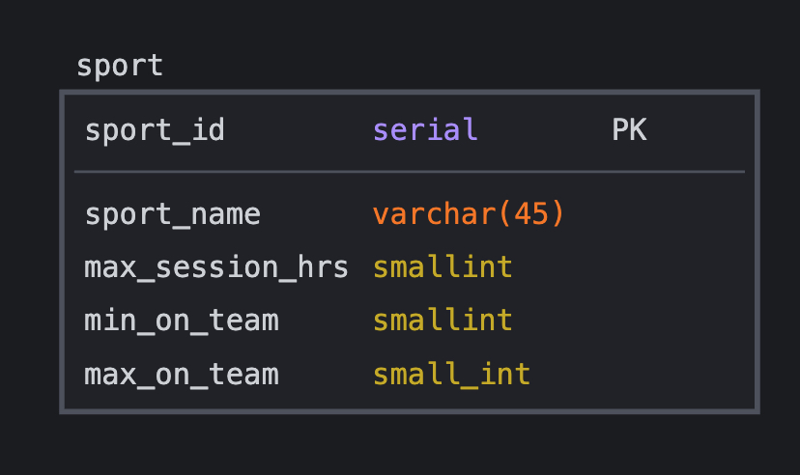
sport

Slide 27
Create an ERD, with SqlDBM.com, for this situation.
A City recreation department manages activities for multiple sports.
There are several venues in the city each is suitable for one or more sports.
Each sport has
  A maximum allowable number of hours for a game(practice).
  A minimum number for youth on a team
  A maximum number for youth on a team
The city manages on or more leagues per sport.
Venues are scheduled in 1-hour blocks.
Blocks are available from 10 AM until 9 PM and always start on the hour.
The schedule will be for an 84 day season (12 Weeks).
Each league must have at least four teams but no more than sixteen teams.
  Some but not all of these leagues will be co-ed.
City youth can play one or more sports. But can only play one team per sport.

Slide 28
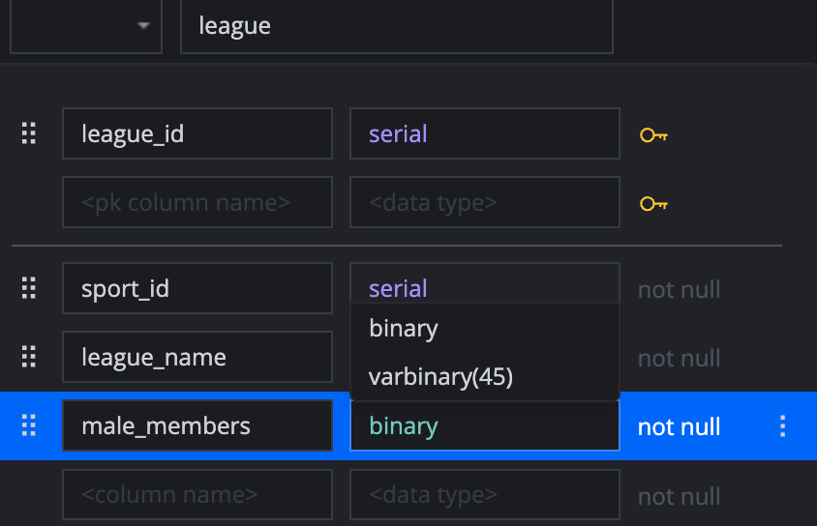
league

Slide 29
Create an ERD, with SqlDBM.com, for this situation.
A City recreation department manages activities for multiple sports.
There are several venues in the city each is suitable for one or more sports.
Each sport has
  A maximum allowable number of hours for a game(practice).
  A minimum number for youth on a team
  A maximum number for youth on a team
The city manages on or more leagues per sport.
Venues are scheduled in 1-hour blocks.
Blocks are available from 10 AM until 9 PM and always start on the hour.
The schedule will be for an 84 day season (12 Weeks).
Each league must have at least four teams but no more than sixteen teams.
  Some but not all of these leagues will be co-ed.
City youth can play one or more sports. But can only play one team per sport.

Slide 30
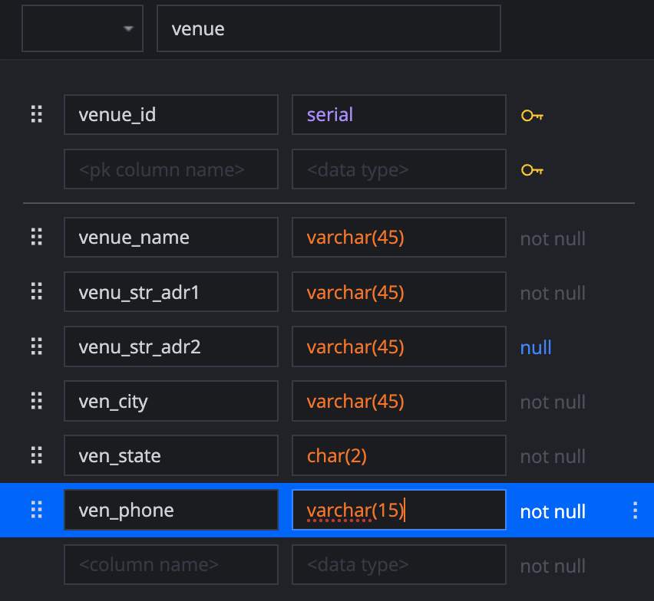
venue

Slide 31
Create an ERD, with SqlDBM.com, for this situation.
A City recreation department manages activities for multiple sports.
There are several venues in the city each is suitable for one or more sports.
Each sport has
  A maximum allowable number of hours for a game(practice).
  A minimum number for youth on a team
  A maximum number for youth on a team
The city manages on or more leagues per sport.
Venues are scheduled in 1-hour blocks.
Blocks are available from 10 AM until 9 PM and always start on the hour.
The schedule will be for an 84 day season (12 Weeks).
Each league must have at least four teams but no more than sixteen teams.
  Some but not all of these leagues will be co-ed.
City youth can play one or more sports. But can only play one team per sport.

Slide 32
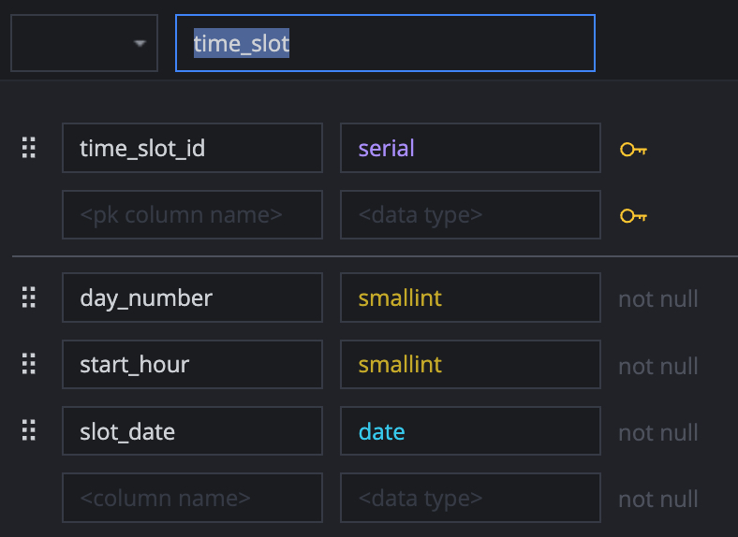
schedule

Slide 33
Create an ERD, with SqlDBM.com, for this situation.
A City recreation department manages activities for multiple sports.
There are several venues in the city each is suitable for one or more sports.
Each sport has
  A maximum allowable number of hours for a game(practice).
  A minimum number for youth on a team
  A maximum number for youth on a team
The city manages on or more leagues per sport.
Venues are scheduled in 1-hour blocks.
Blocks are available from 10 AM until 9 PM and always start on the hour.
The schedule will be for an 84 day season (12 Weeks).
Each league must have at least four teams but no more than sixteen teams.
  Some but not all of these leagues will be co-ed.
City youth can play one or more sports. But can only play one team per sport.

Slide 34
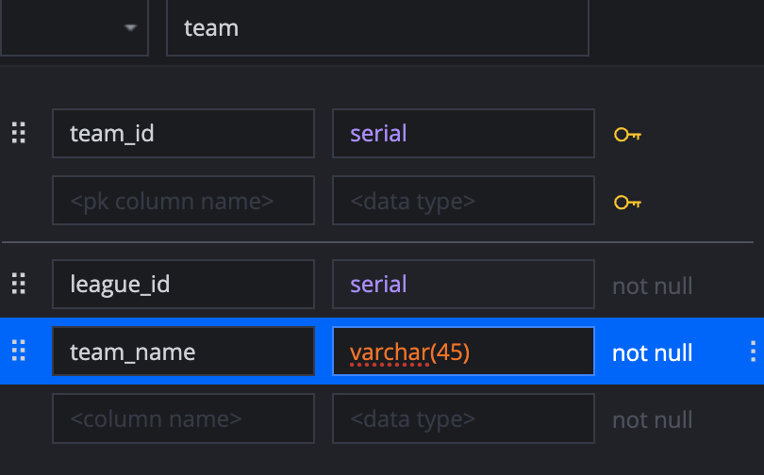
team

Slide 35
Create an ERD, with SqlDBM.com, for this situation.
A City recreation department manages activities for multiple sports.
There are several venues in the city each is suitable for one or more sports.
Each sport has
  A maximum allowable number of hours for a game(practice).
  A minimum number for youth on a team
  A maximum number for youth on a team
The city manages on or more leagues per sport.
Venues are scheduled in 1-hour blocks.
Blocks are available from 10 AM until 9 PM and always start on the hour.
The schedule will be for an 84 day season (12 Weeks).
Each league must have at least four teams but no more than sixteen teams.
  Some but not all of these leagues will be co-ed.
City youth can play one or more sports. But can only play one team per sport.

Slide 36
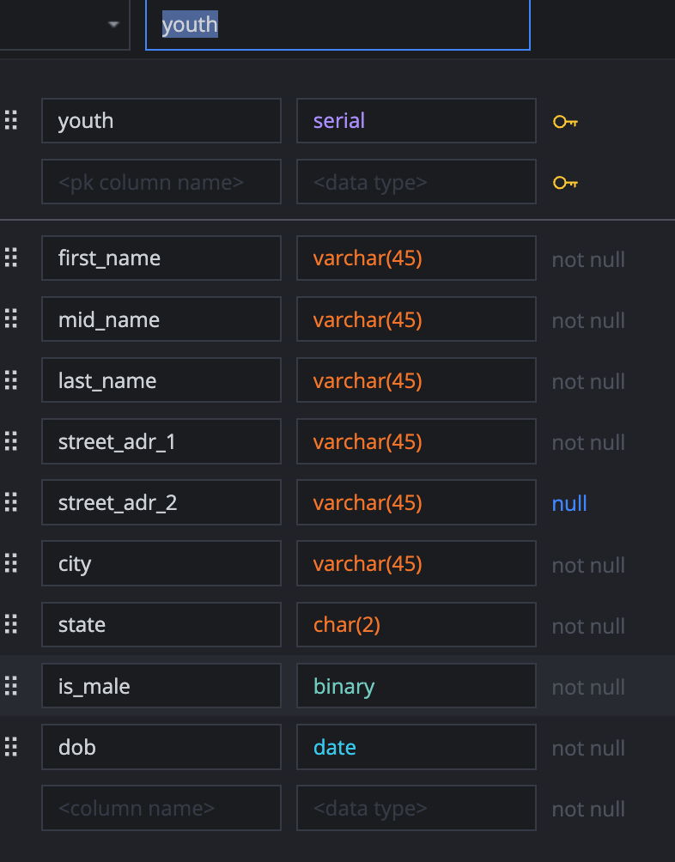
youth

Slide 37
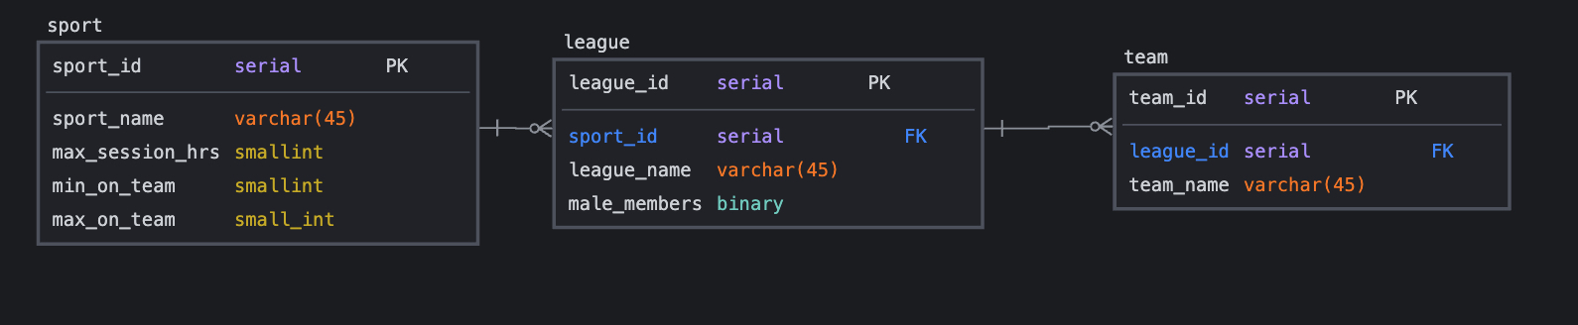
Define relationships between basic entities

Slide 38
Define intersection entities required to enforce stated needs

Slide 39
Create an ERD, with SqlDBM.com, for this situation.
A City recreation department manages activities for multiple sports.
There are several venues in the city each is suitable for one or more sports.
Each sport has
  A maximum allowable number of hours for a game(practice).
  A minimum number for youth on a team
  A maximum number for youth on a team
The city manages on or more leagues per sport.
Venues are scheduled in 1-hour blocks.
Blocks are available from 10 AM until 9 PM and always start on the hour.
The schedule will be for an 84 day season (12 Weeks).
Each league must have at least four teams but no more than sixteen teams.
  Some but not all of these leagues will be co-ed.
City youth can play one or more sports. But can only play one team per sport.

Slide 40
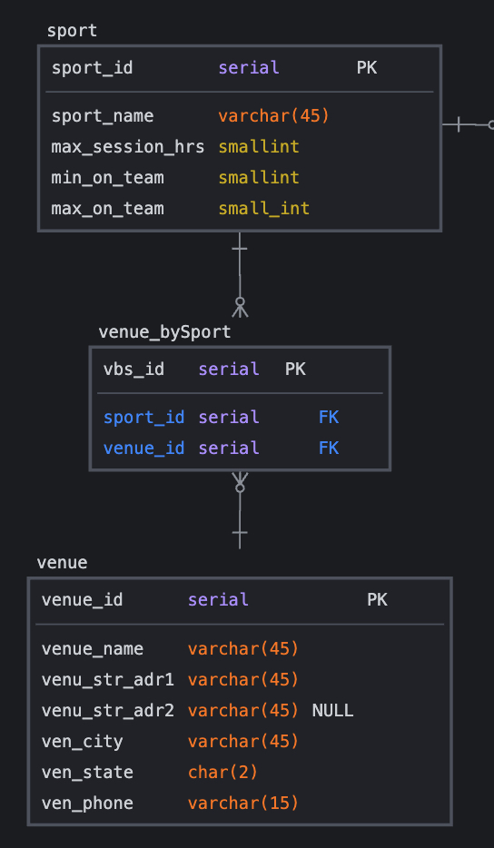

Slide 41
The objective of this database is to:
For each youth registered in the city, capture their name, home address, gender and age
Record the names of each sport, and the teams that play that sport.
Record the youth members on each team.
Record if a player was present or absent at each game/practice.
Ensure no youth is scheduled to play in multiple games/practice sessions at same time.
Record the venue and time where each team is scheduled to play/practice.
  The database should have a way to record the opposing team or that it was a practice and not a game.

Slide 42
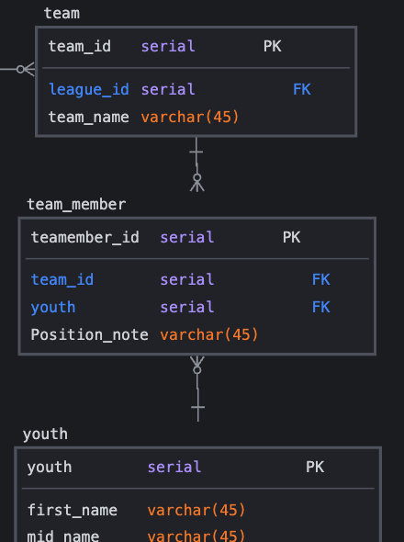

Slide 43
The objective of this database is to:
For each youth registered in the city, capture their name, home address, gender and age
Record the names of each sport, and the teams that play that sport.
Record the youth members on each team.
Record if a player was present or absent at each game/practice.
Ensure no youth is scheduled to play in multiple games/practice sessions at same time.
Record the venue and time where each team is scheduled to play/practice.
  The database should have a way to record the opposing team or that it was a practice and not a game.

Slide 44
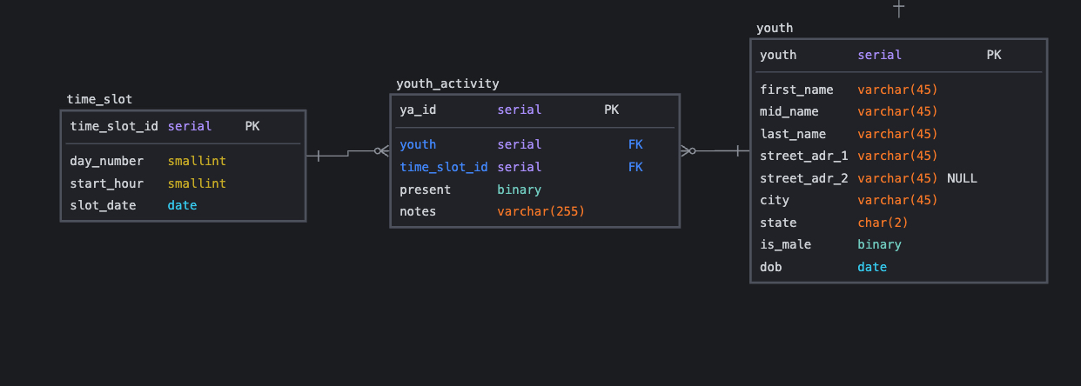

Slide 45
The objective of this database is to:
For each youth registered in the city, capture their name, home address, gender and age
Record the names of each sport, and the teams that play that sport.
Record the youth members on each team.
Record if a player was present or absent at each game/practice.
Ensure no youth is scheduled to play in multiple games/practice sessions at same time.
Record the venue and time where each team is scheduled to play/practice.
  The database should have a way to record the opposing team or that it was a practice and not a game.

Slide 46
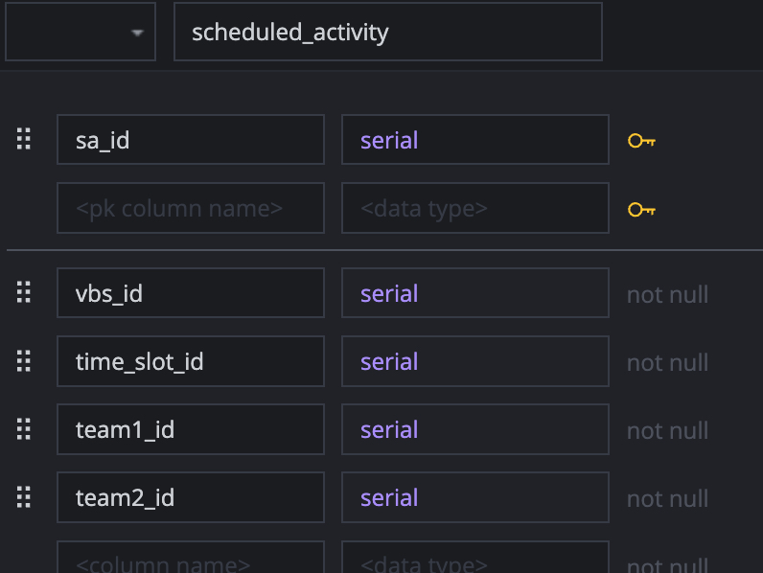

Slide 47
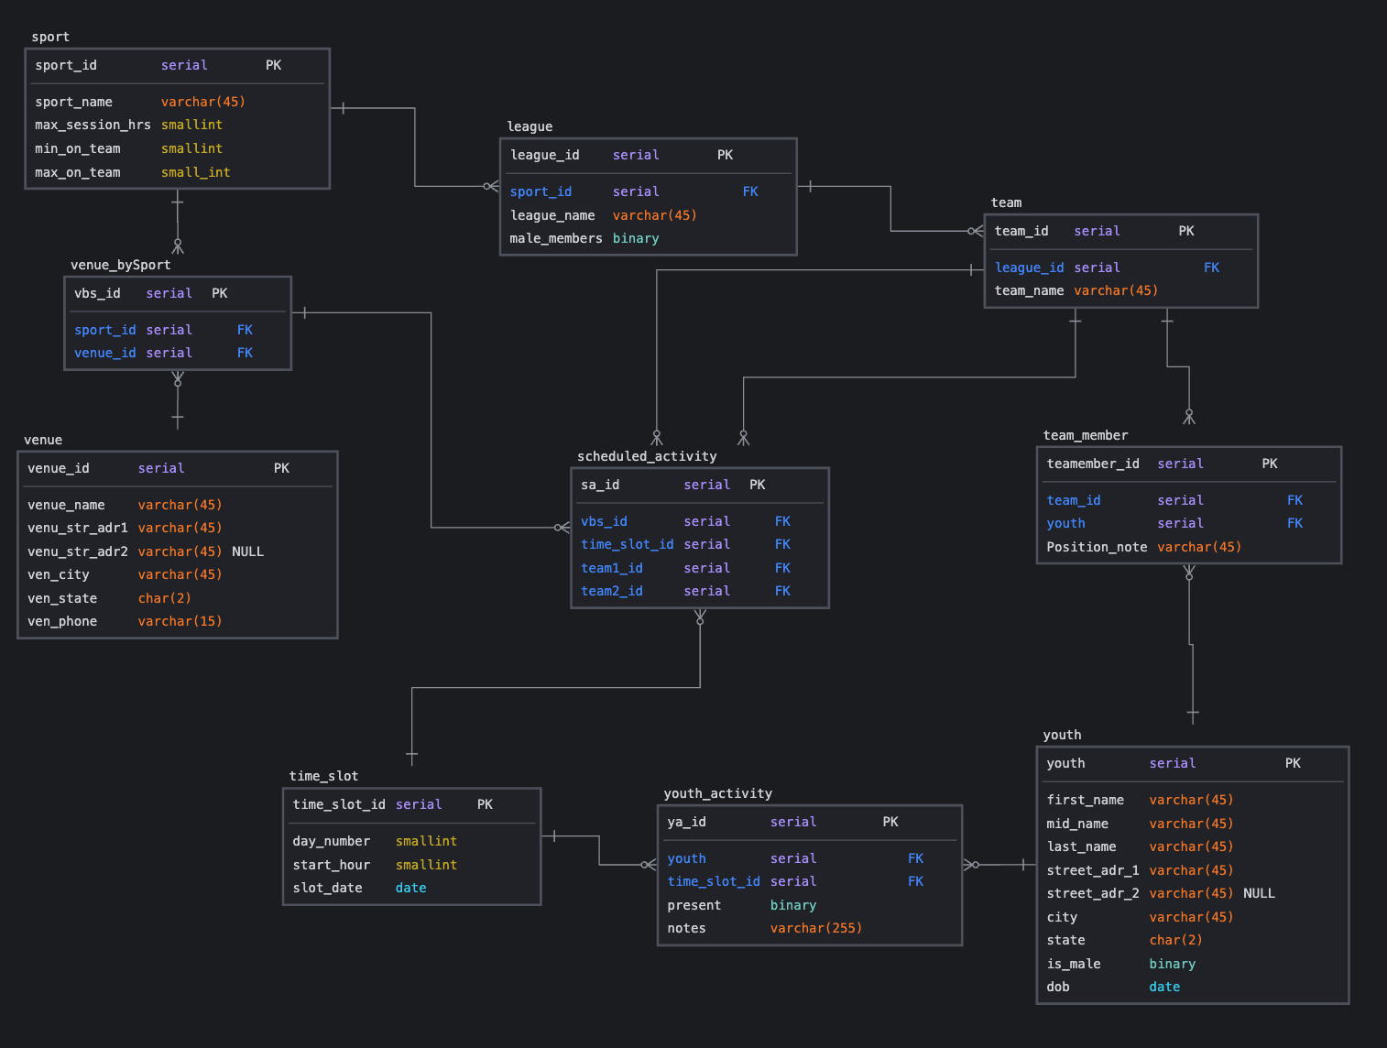
Complete ERD

Slide 48
CIT 170 (3 Credit Hours)
Database Design Fundamentals
Sample
Final Exam with Examination
Adjunct Instructor – Charles W (Bill) Marshall
cmarshall0050@kctcs.edu
While Blackboard will be the official site for assignments and to turn in assignments
Supplemental information is available at https://www.cwmclass.com

